Slide 1
Using Elastic Load Balancers and EC2 Auto Scaling to Support AWS Workloads

Slide 4
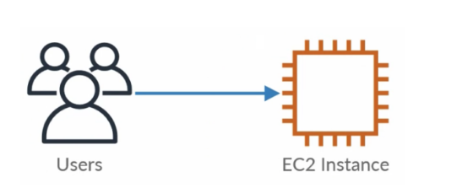

Slide 5
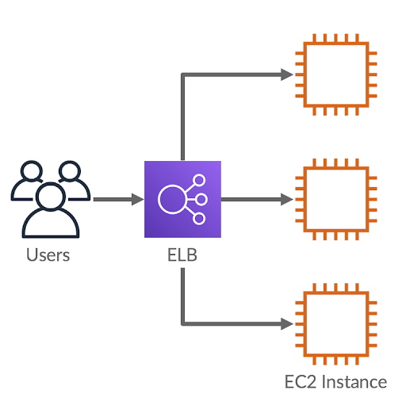

Slide 6


Slide 7
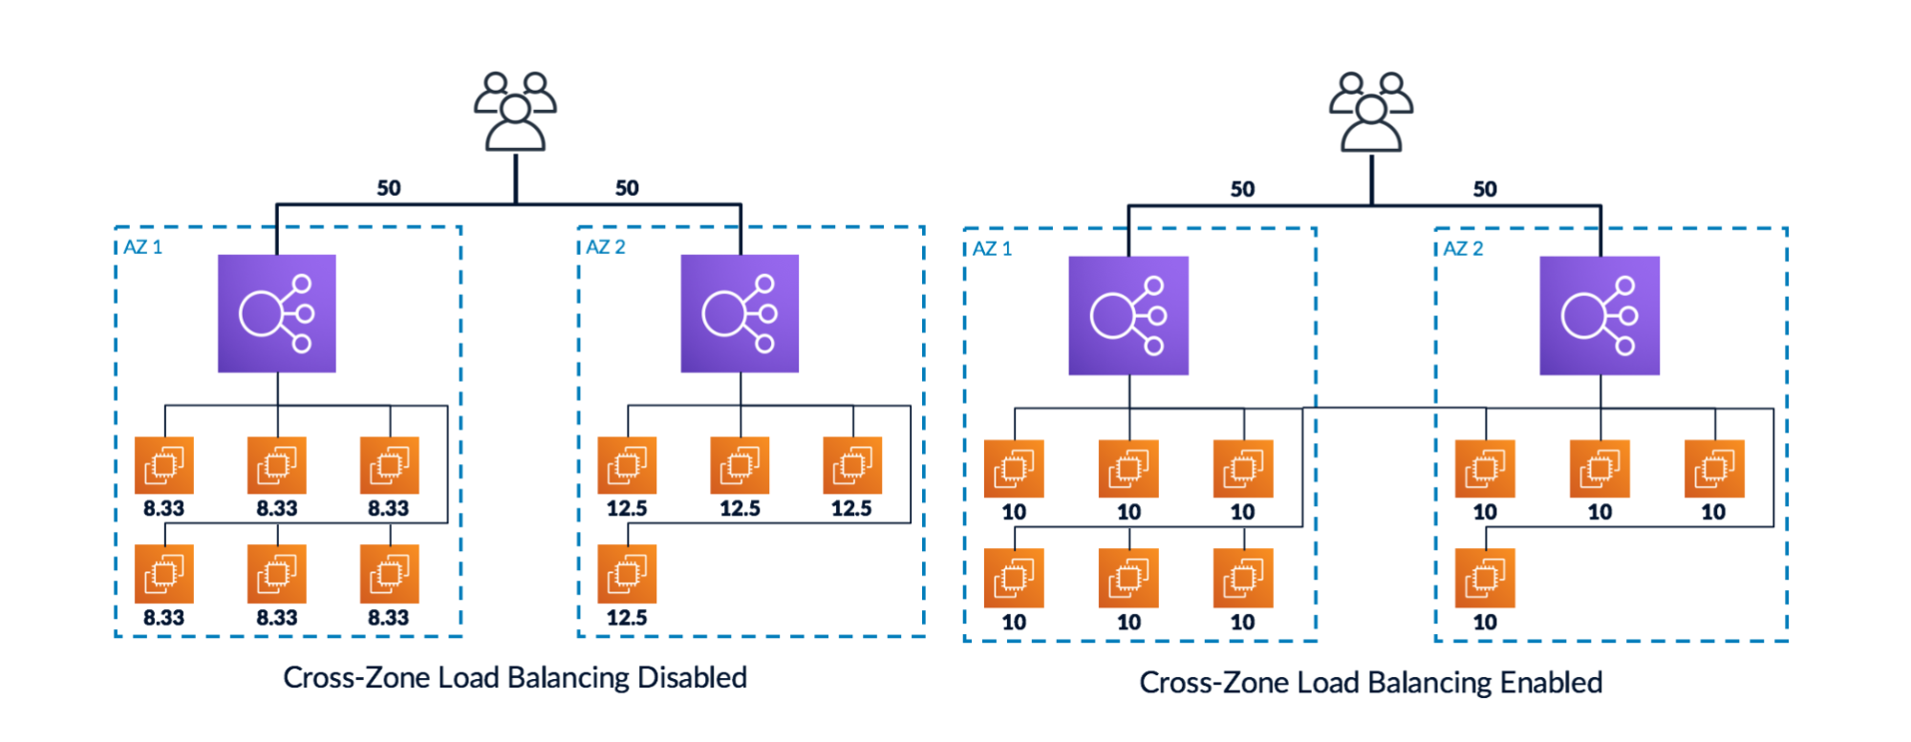

Slide 9
